Slide 1
Competitors Analysis Market Research
For HashA
SandhyaSN

Slide 2
MARKET RESEARCH
Competitor Analysis
27M
1.84K
1.00%
5.78%
Total Sales
Avg Price
Market Share
Ad Efficiency
SandhyaSN

Slide 3
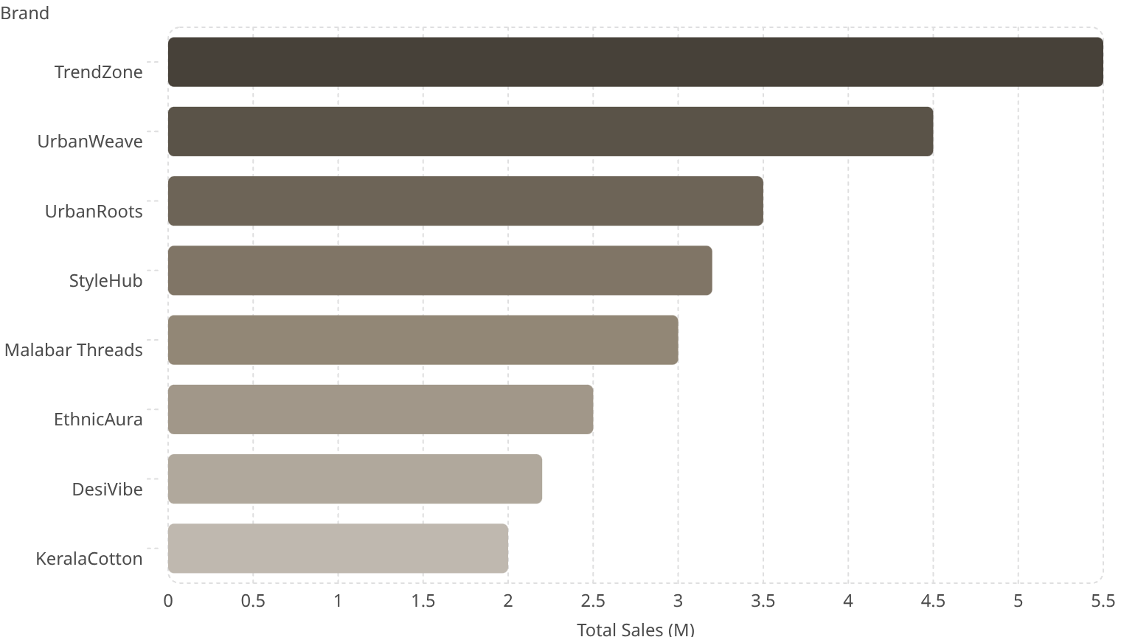
Total Sales by Brand
Key Takeaway
TrendZone leads the market at ~5.5M in total sales. Malabar Threads sits at ~3.0M — a mid-tier performer with clear room to grow.
Cities covered: Bangalore, Kochi, Kozhikode, Thrissur, Trivandrum
SandhyaSN

Slide 4
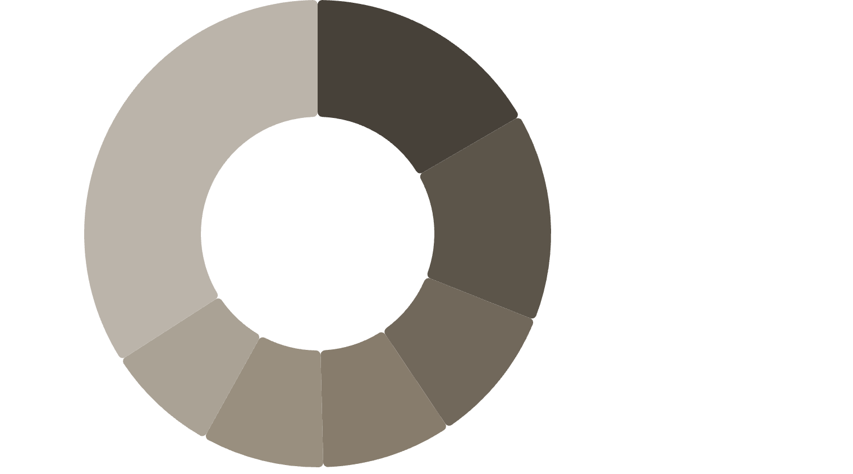
Market Share by Brand
Competitive Landscape
TrendZone holds 18.3% market share — the clear leader. Malabar Threads holds 9.32%, positioned in the mid-tier among 8 tracked brands.
TrendZone·16.63%
·16.63%
·
UrbanWeave·14.39%
·14.39%
·
UrbanRoots·9.56%
·9.56%
·
Target segments span Mass, Mid, and Premium tiers across all brands.
StyleHub·9.03%
·9.03%
·
Malabar Threads·8.47%
·8.47%
·
EthnicAura·7.83%
·7.83%
·
Others·34.08%
·34.08%
·
SandhyaSN

Slide 5
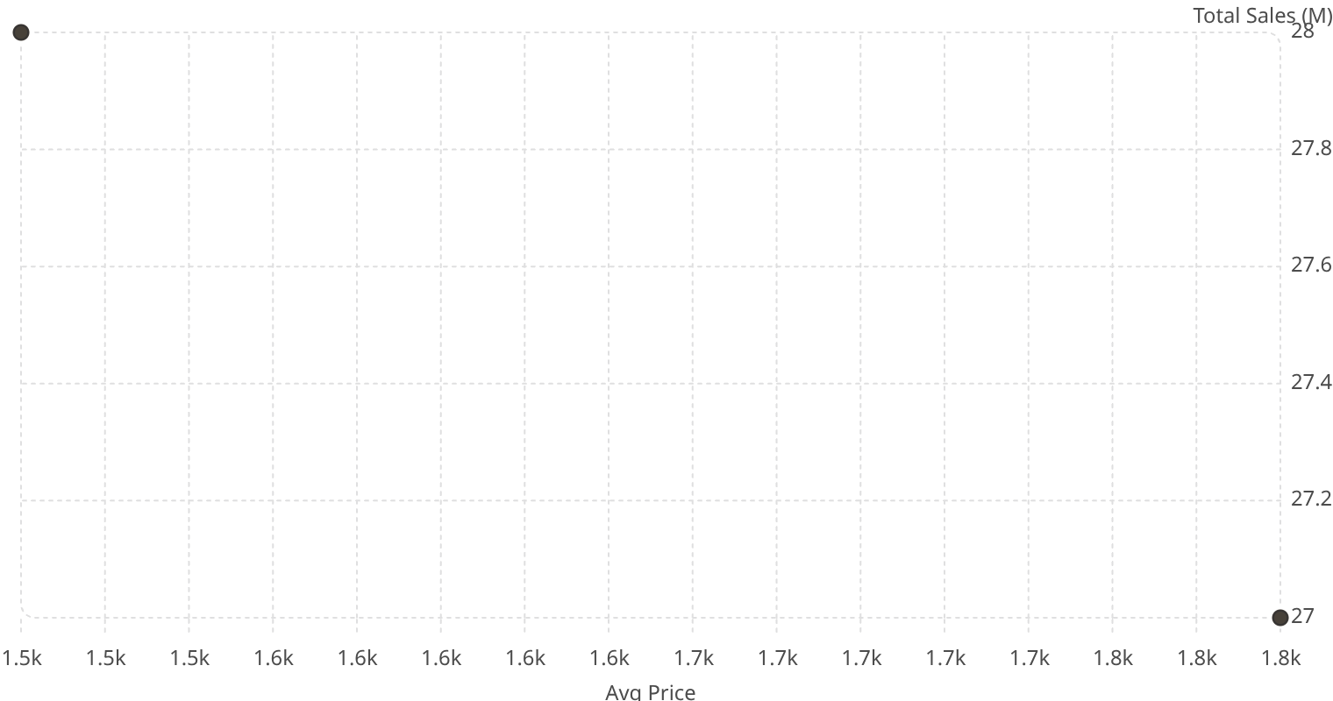
Avg Price vs. Total Sales
Total Sales (M)
Price-Performance Insight
Higher average price (~1.8K) correlates with slightly lower total sales (~27M), suggesting volume trade-offs at premium price points.
Categories tracked: Western Wear, Ethnic Wear, Accessories, Fusion Wear
SandhyaSN

Slide 6
DEEP INSIGHTS
What the Data Tells Us
Premium Brands Dominate Revenue
Malabar Threads: Stuck in the Middle
Customers are willing to pay premium — high-end positioning drives stronger sales.
Not strongly positioned — lacks clear identity between mid and premium tiers.
Ad Spend ≠ High Return
Digital Presence is the Key Driver
Some brands spend less but outperform. ROI focus over raw budget is critical.
Online sales are growing in importance. Accessories remain low-revenue across brands.
SandhyaSN

Slide 7
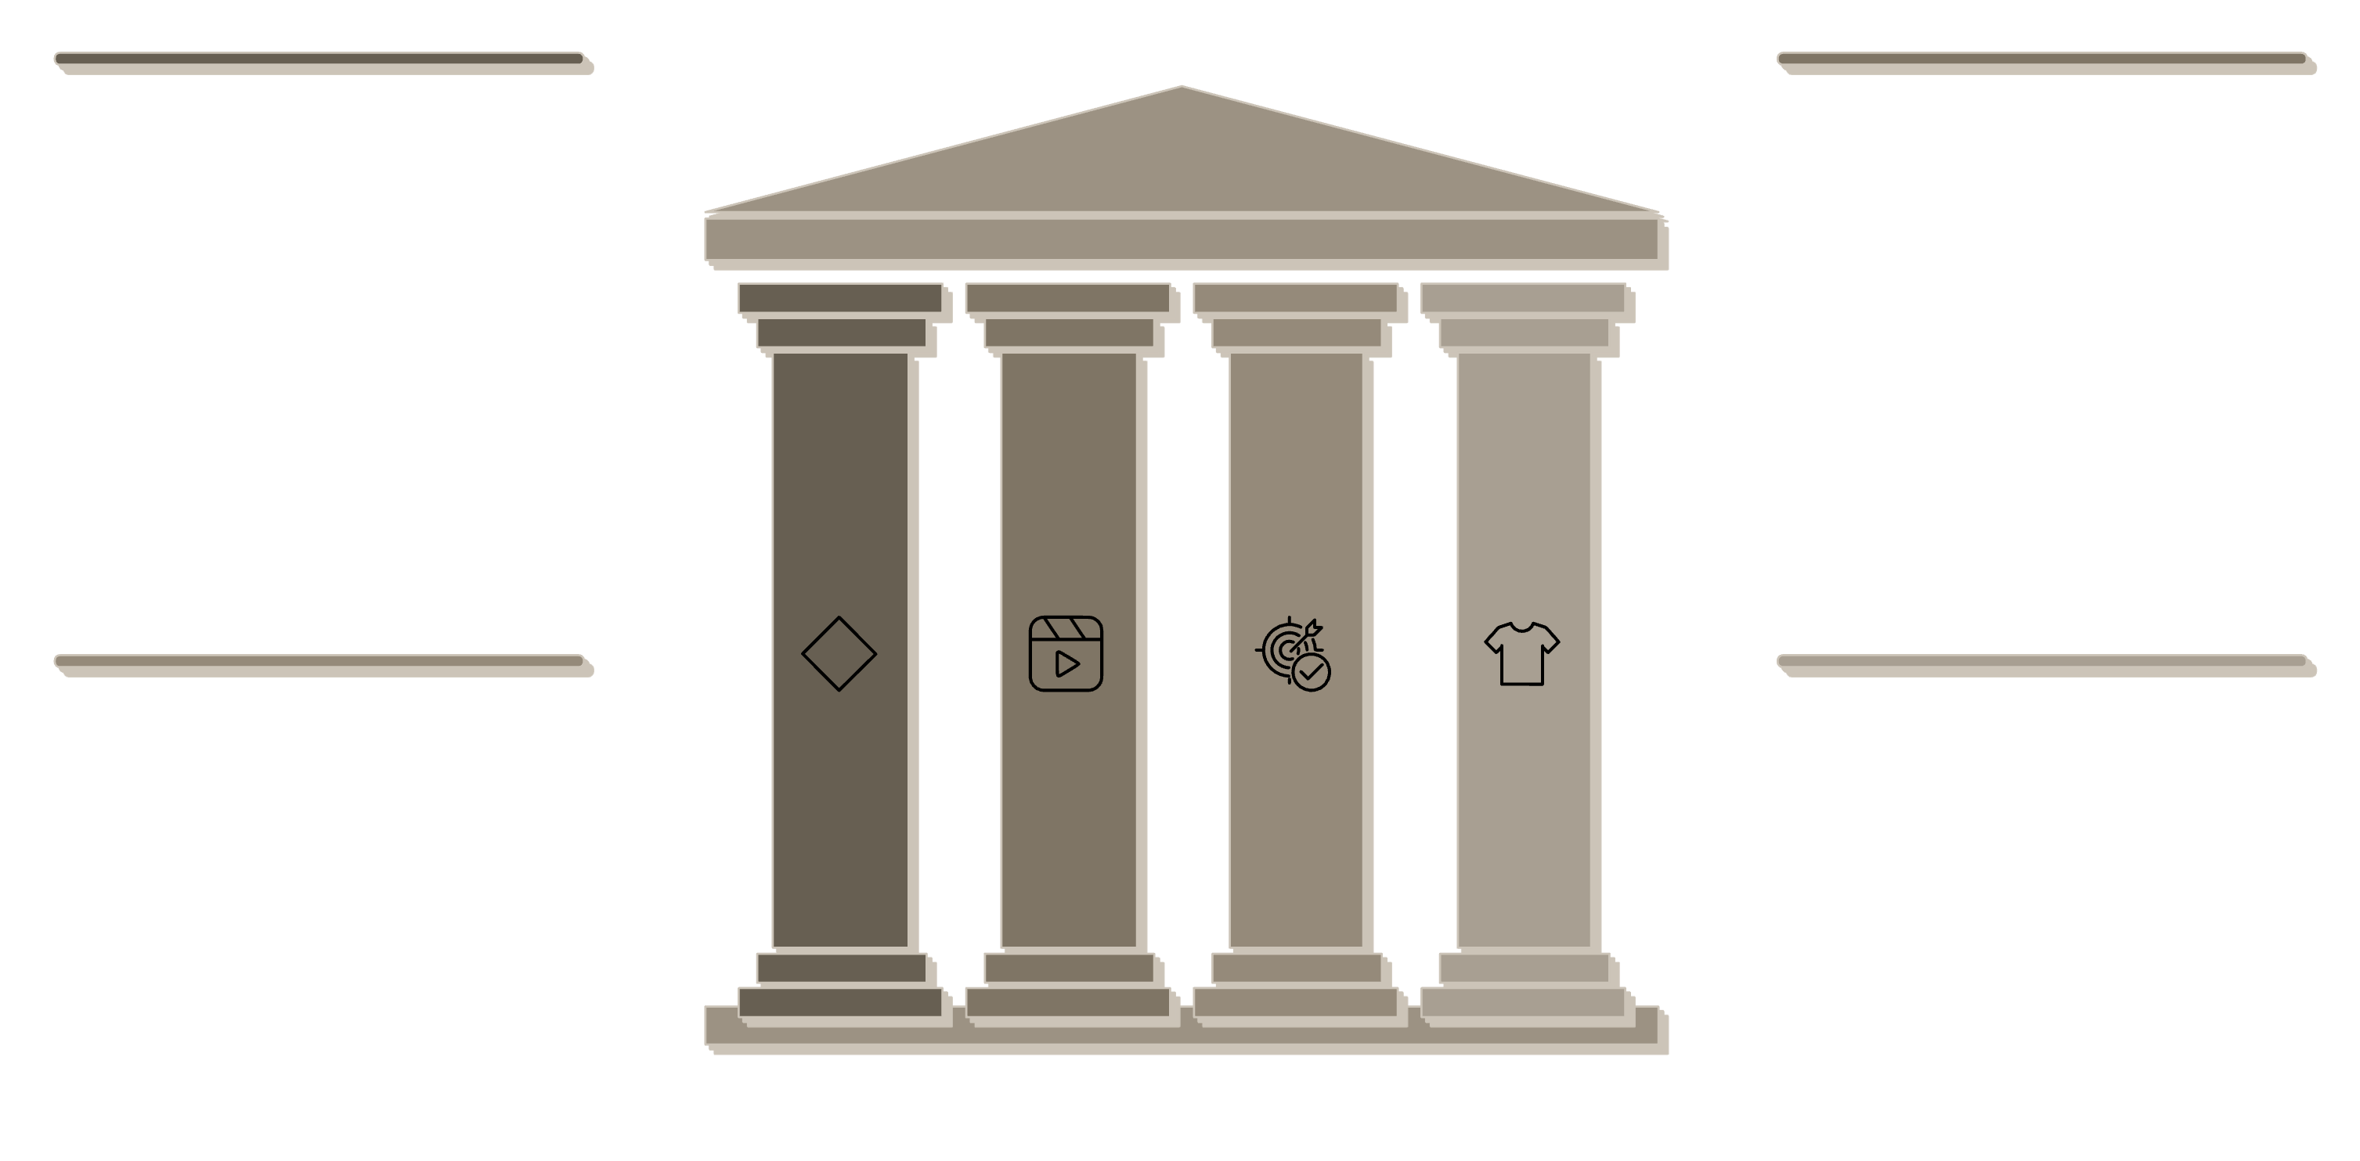

STRATEGY
Malabar Threads: Strategic Roadmap
Reposition to Premium
Digital Expansion
Instagram, influencers, and website optimization
Slight price increase; align with premium perception
ROI-Focused Ads
Product Focus
Target high-performing audiences and retarget
Ethnic & Fusion trend-led seasonal collections
Malabar Threads must commit to a premium positioning, invest in digital channels with ROI discipline, and lead with Ethnic and Fusion product lines to capture growing market demand.
SandhyaSN

Slide 8
Conclusion
Digital presence is the key growth driver.
Premium Brands dominate Revenue.
Digital Expansion can increase the online sales percentage.
Starting with Instagram marketing, influencer campaigns and website optimization as primary actions preferred.
SandhyaSN

